Slide 1
Foundations of Inclusive Education
(Dis)Ability Awareness

Slide 2


Slide 3



Ability Awareness
Understanding of issues, abilities and goals
Creating sensitivity
Illustrating positive images and contributions
Developing empathy (not pity or benevolence)

Slide 4
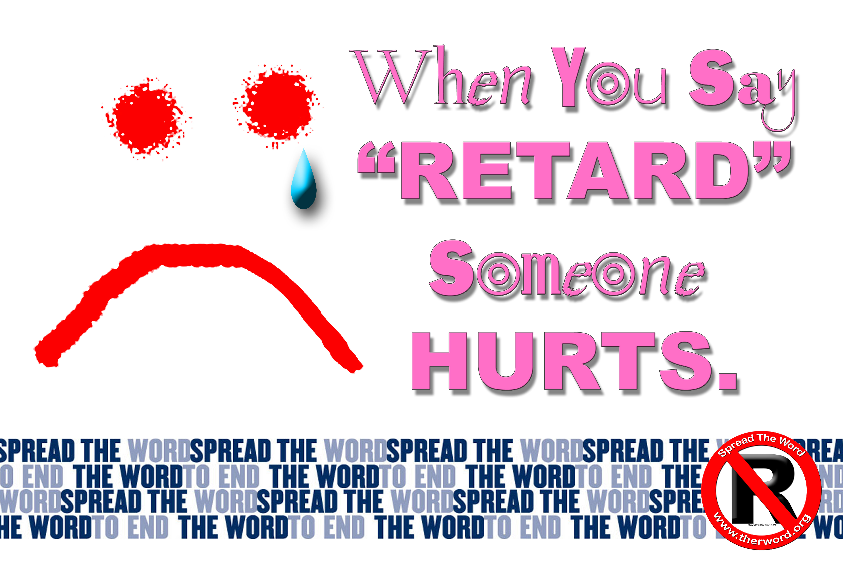
Spread the word to end the word
Raise the consciousness about the dehumanizing and hurtful effects of the R-word
Encourage people to pledge to stop using the R-word

Slide 5


Slide 6

Activity: children’s literature
Work in pairs
Read one of your picture books to your partner
Together, using the guide for reviewing children’s literature, determine if the book is a thumbs up, thumbs down or thumbs sideways
Repeat with a book from other partner

Slide 7

What we think...
Record title, author and recommended age group on sentence strip
Place in the thumbs up (positive portrayal) or thumbs down (negative portrayal) or thumbs sideways (somewhat positive portrayal) column

